Slide 1

The Async JS Saga
Harshit Juneja
@sayhitoharshit

Slide 2
Async Patterns
Callbacks
Promises
Generators and Iterators
Generators and Iterators + promises
Async-await
Web workers
Observables

Slide 3
What’s JS ?
Single Threaded
Non Blocking
Asynchronous
Concurrent
Notes:
When you execute something synchronously, you wait for it to finish before moving on to another task. When you execute something asynchronously, you can move on to another task before it finishes.

Slide 4
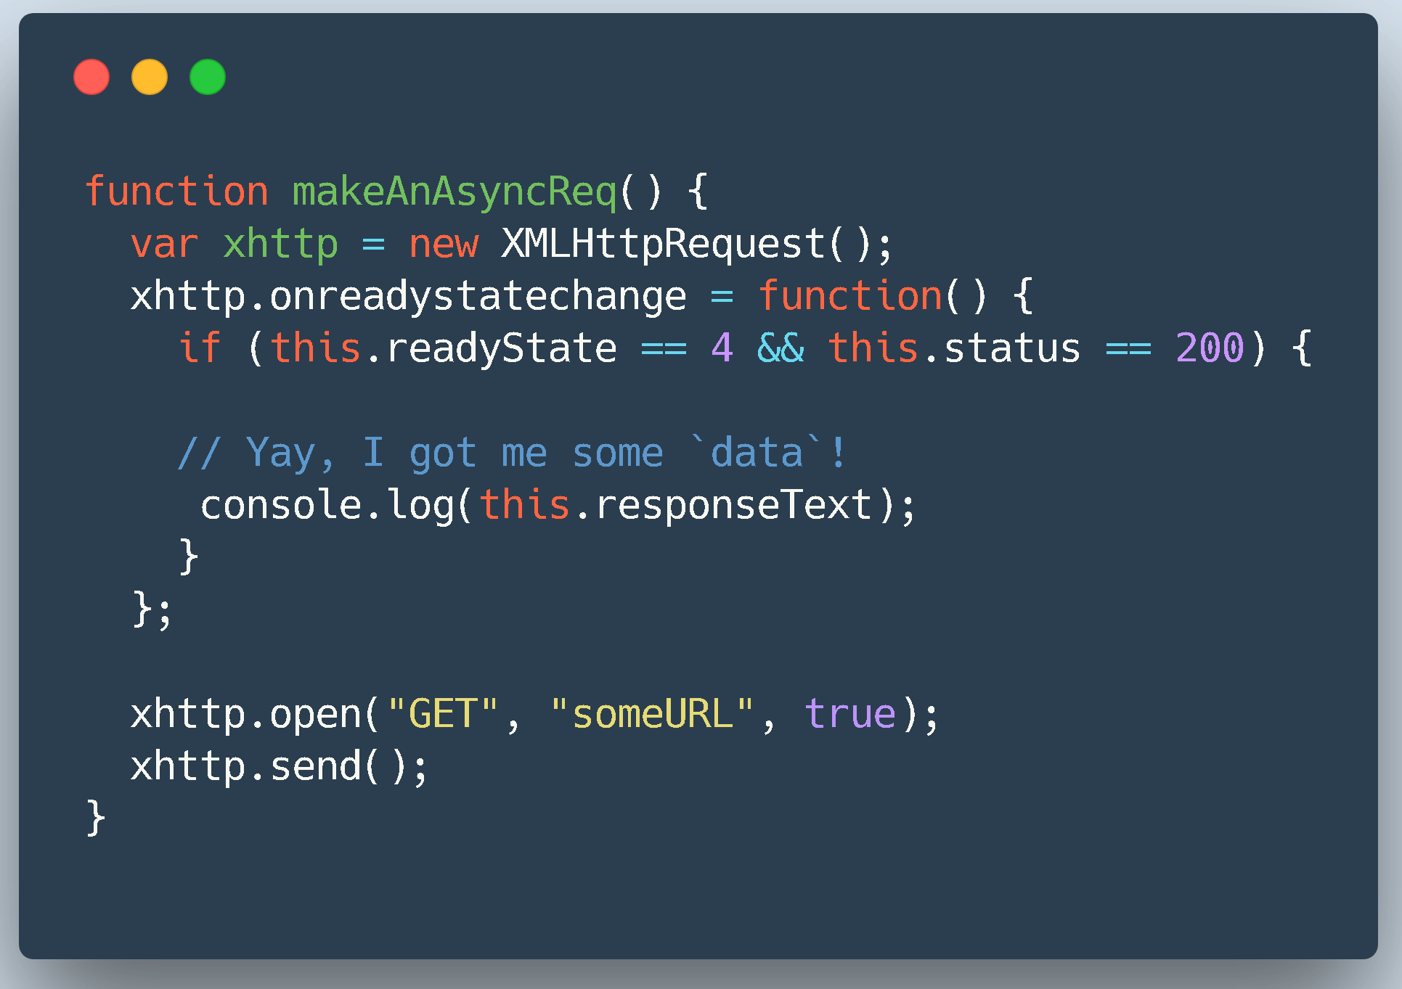
Callbacks

Slide 5
Callbacks

Slide 6
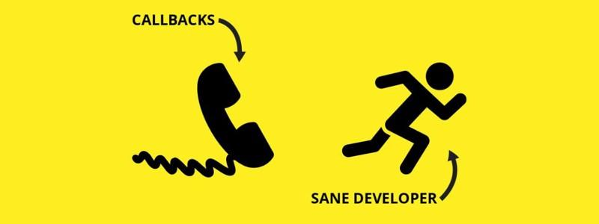
Then I got to know about this!

Slide 7
Problems with Callbacks
Difficult to understand and plan for our sequential brain
Implicitly hands over control to another party
Trust Issues
Callback Hell

Slide 8
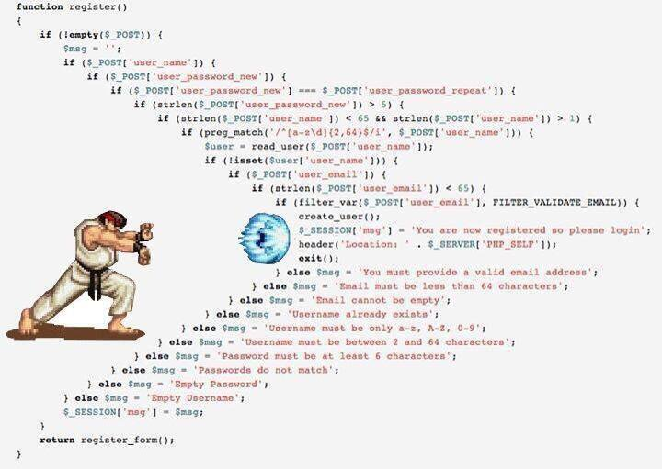

Slide 9
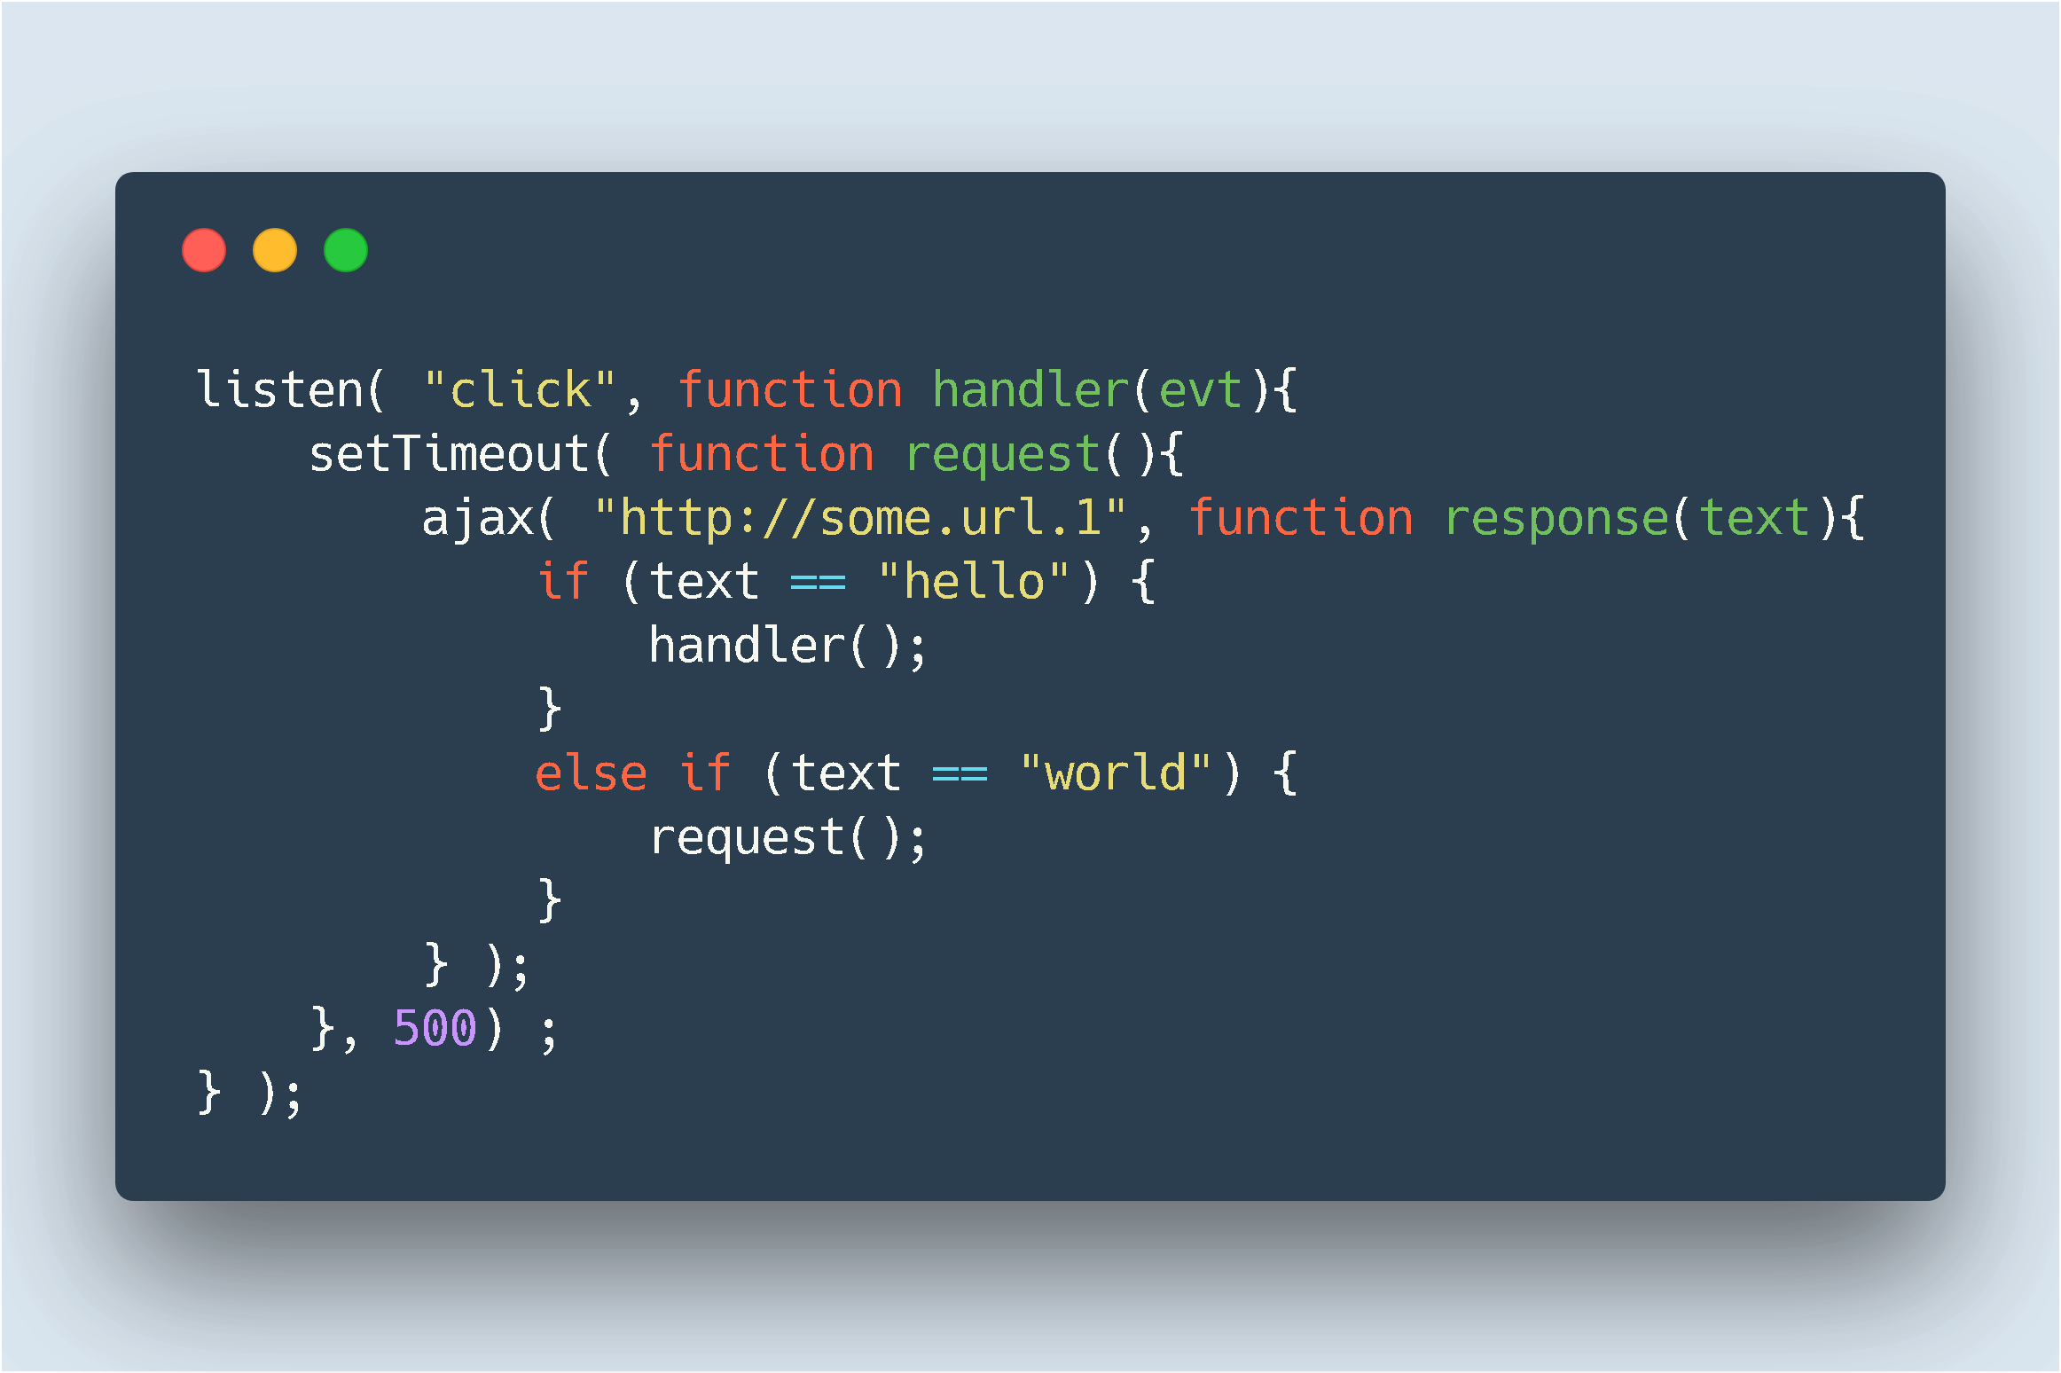
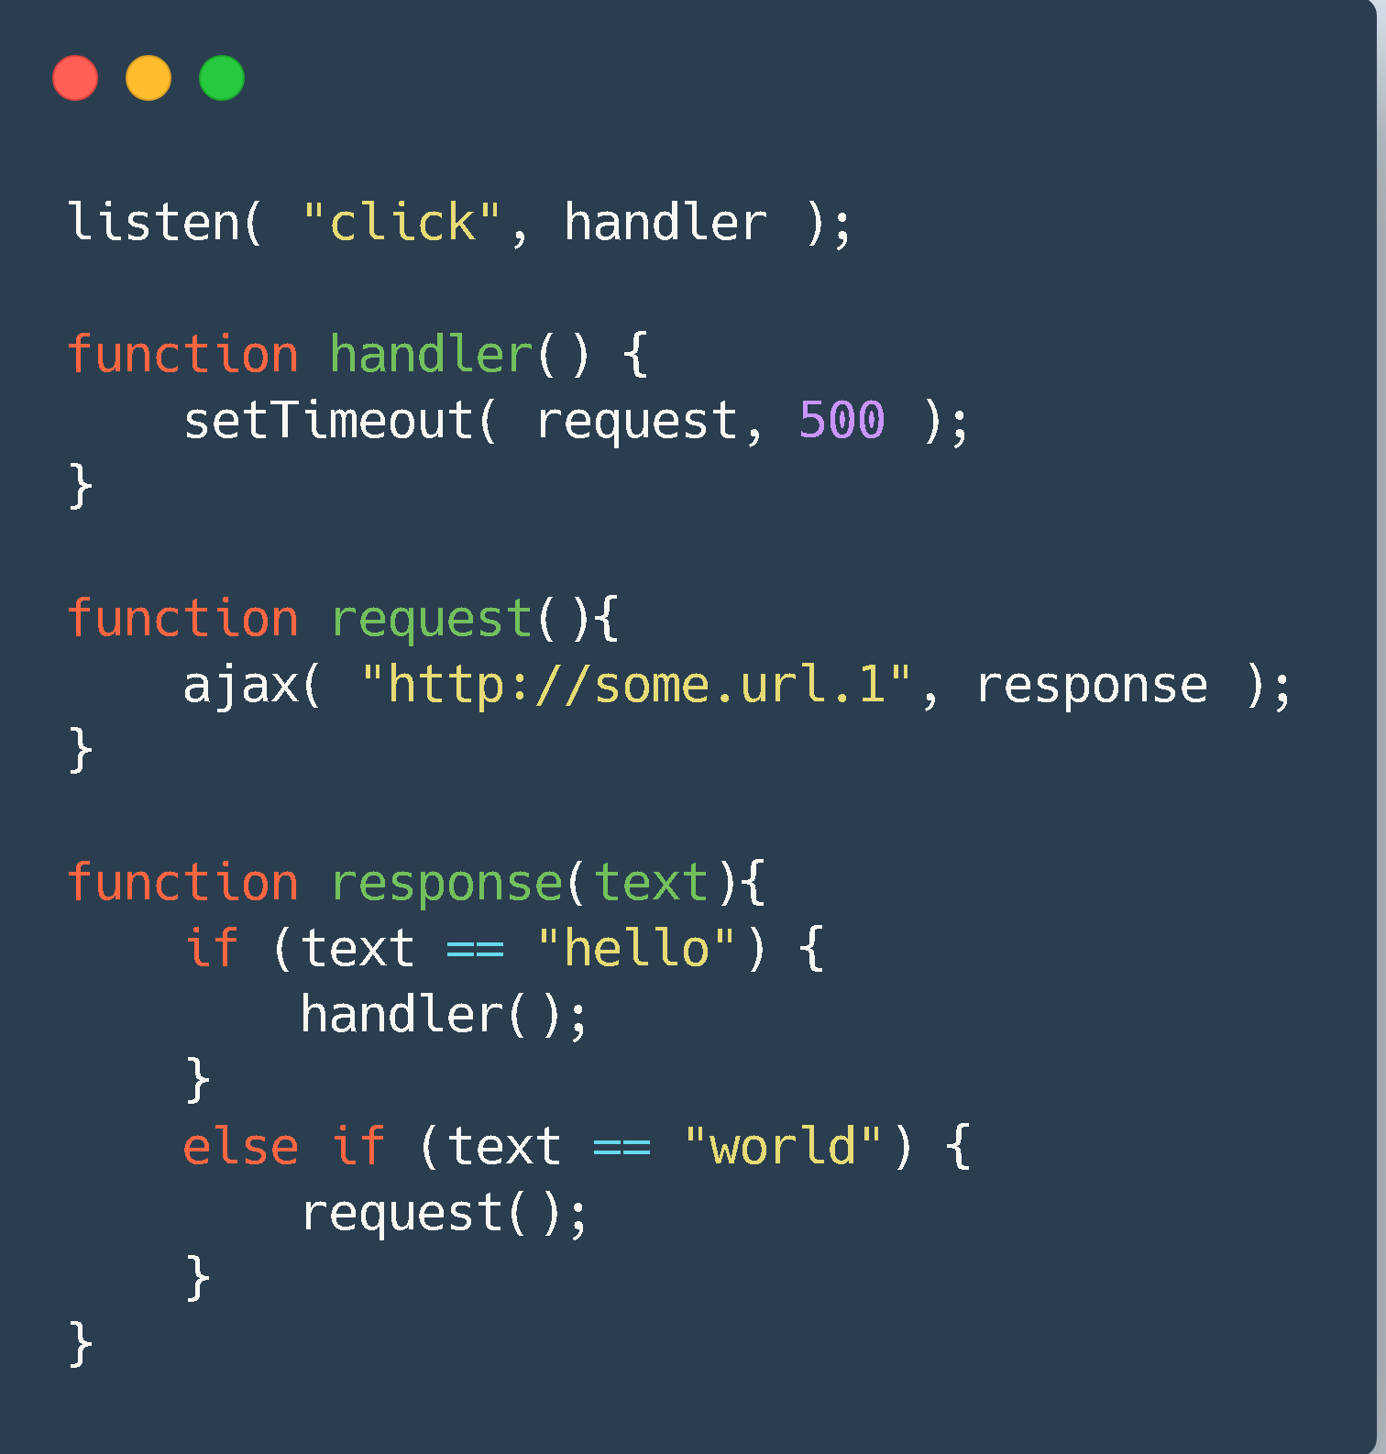
Misconception about Callback Hell!

Slide 10
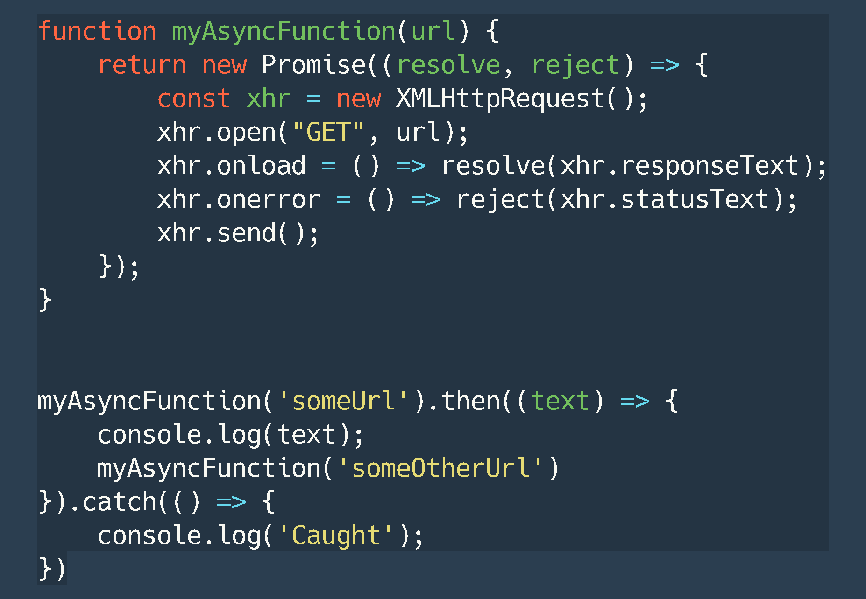
Enter Promises

Slide 11
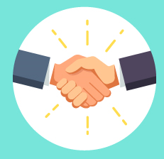
Just Socially Acceptable Callbacks

Slide 12
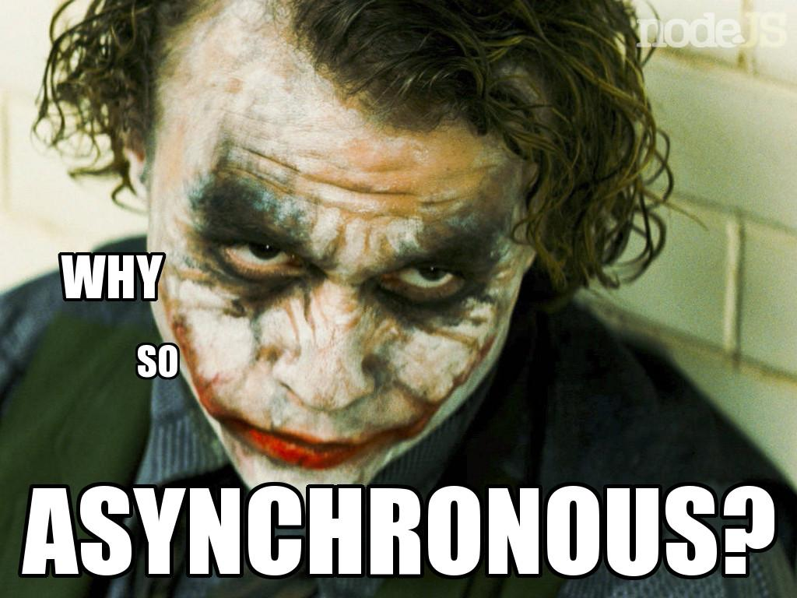

Slide 13
Enter Generators and Iterators
Python inspired concept
Breaks Run-to-completion
Easy on human brain

Slide 14
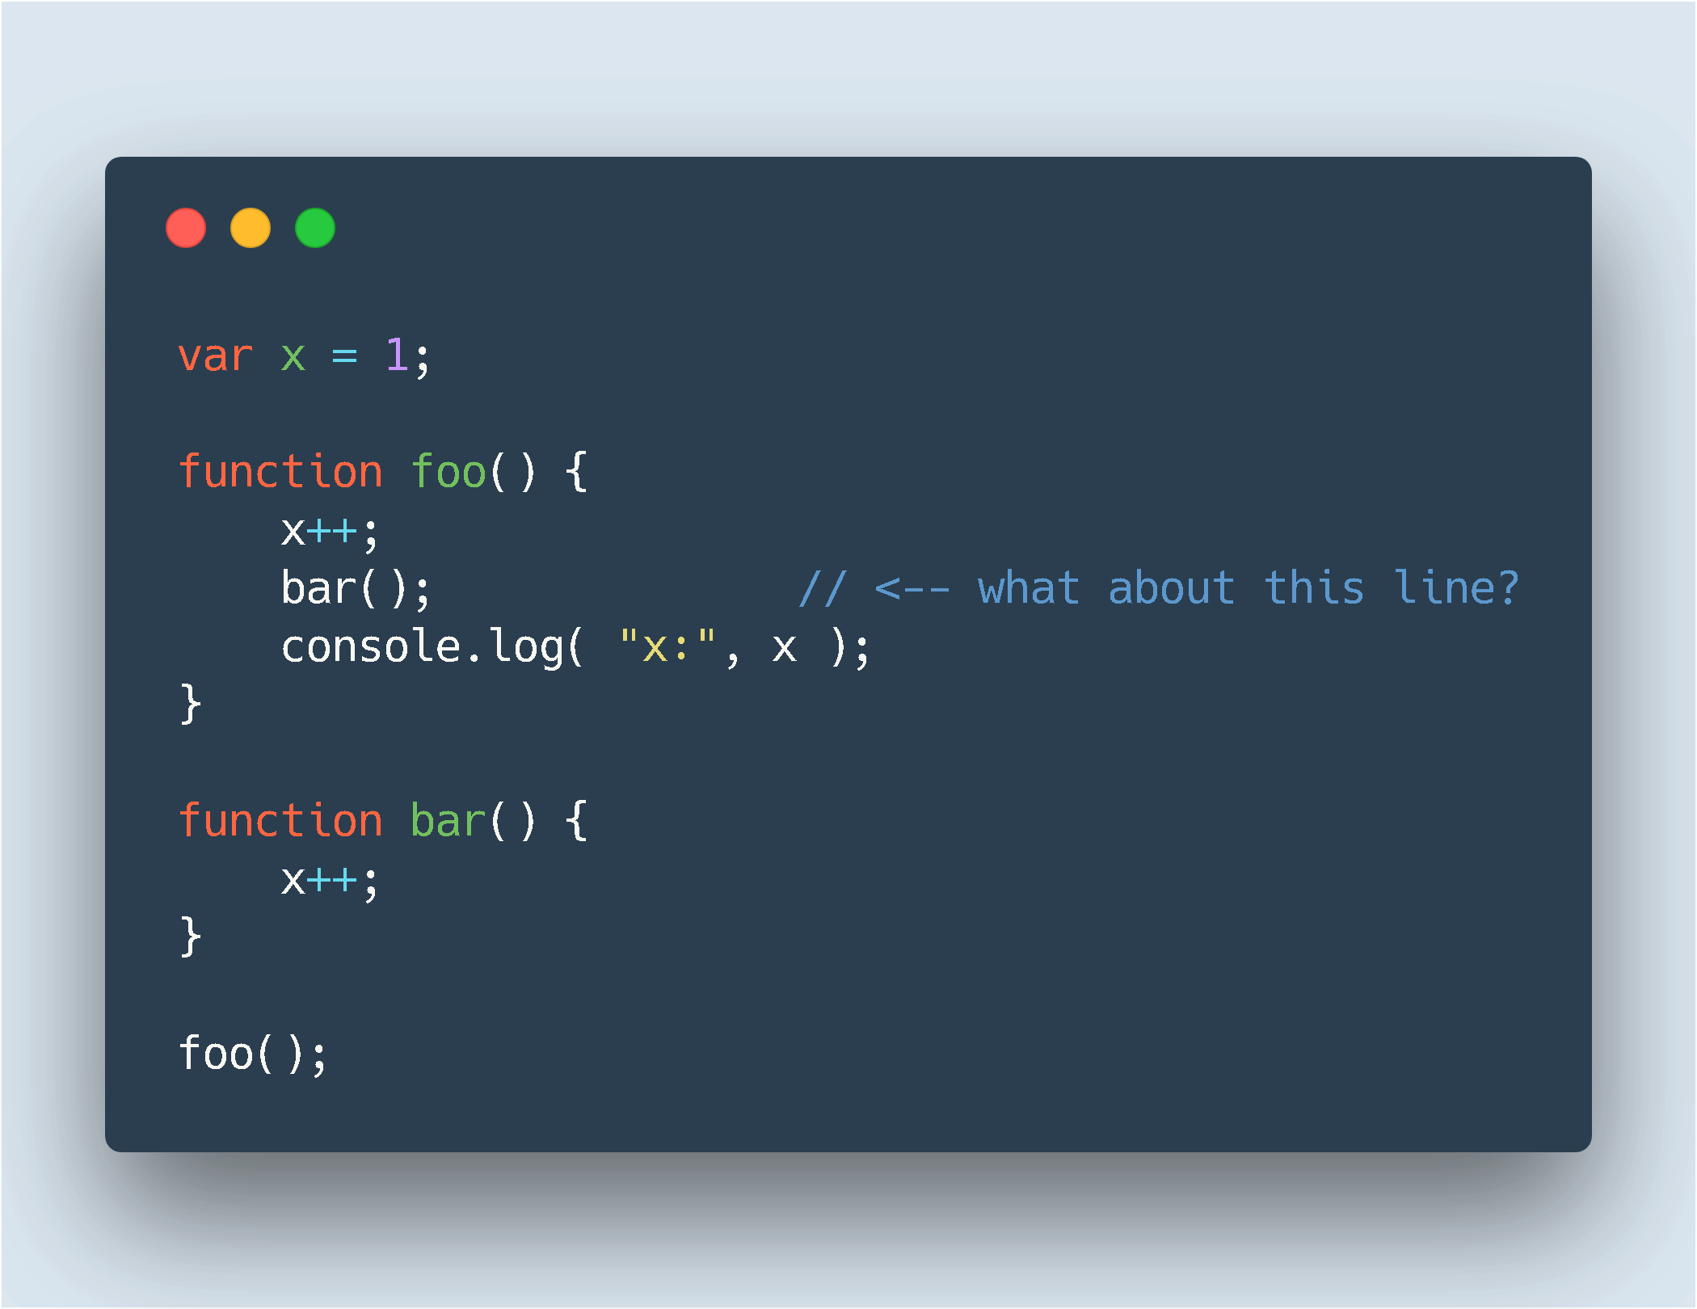

Slide 15
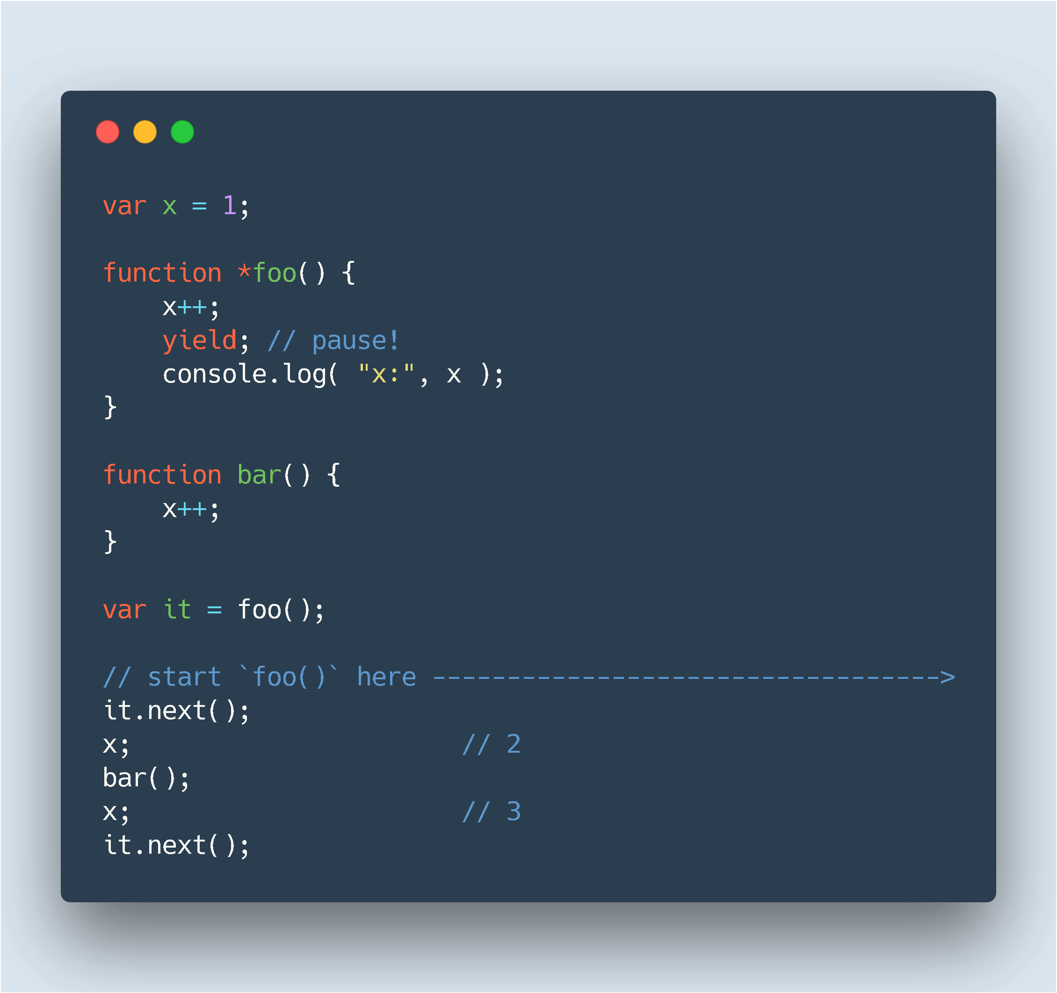

Slide 16
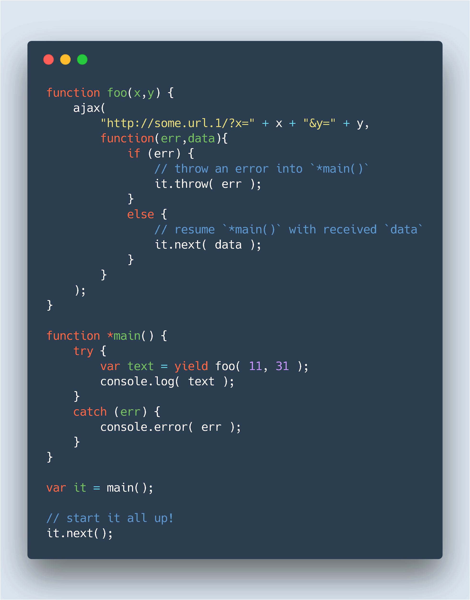

Slide 17
You still have callbacks!

Slide 18
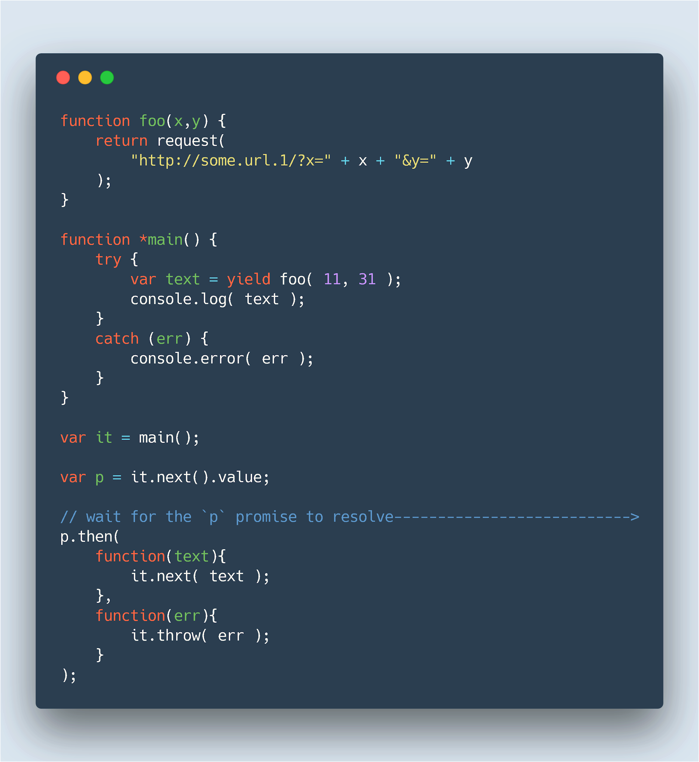

Slide 19
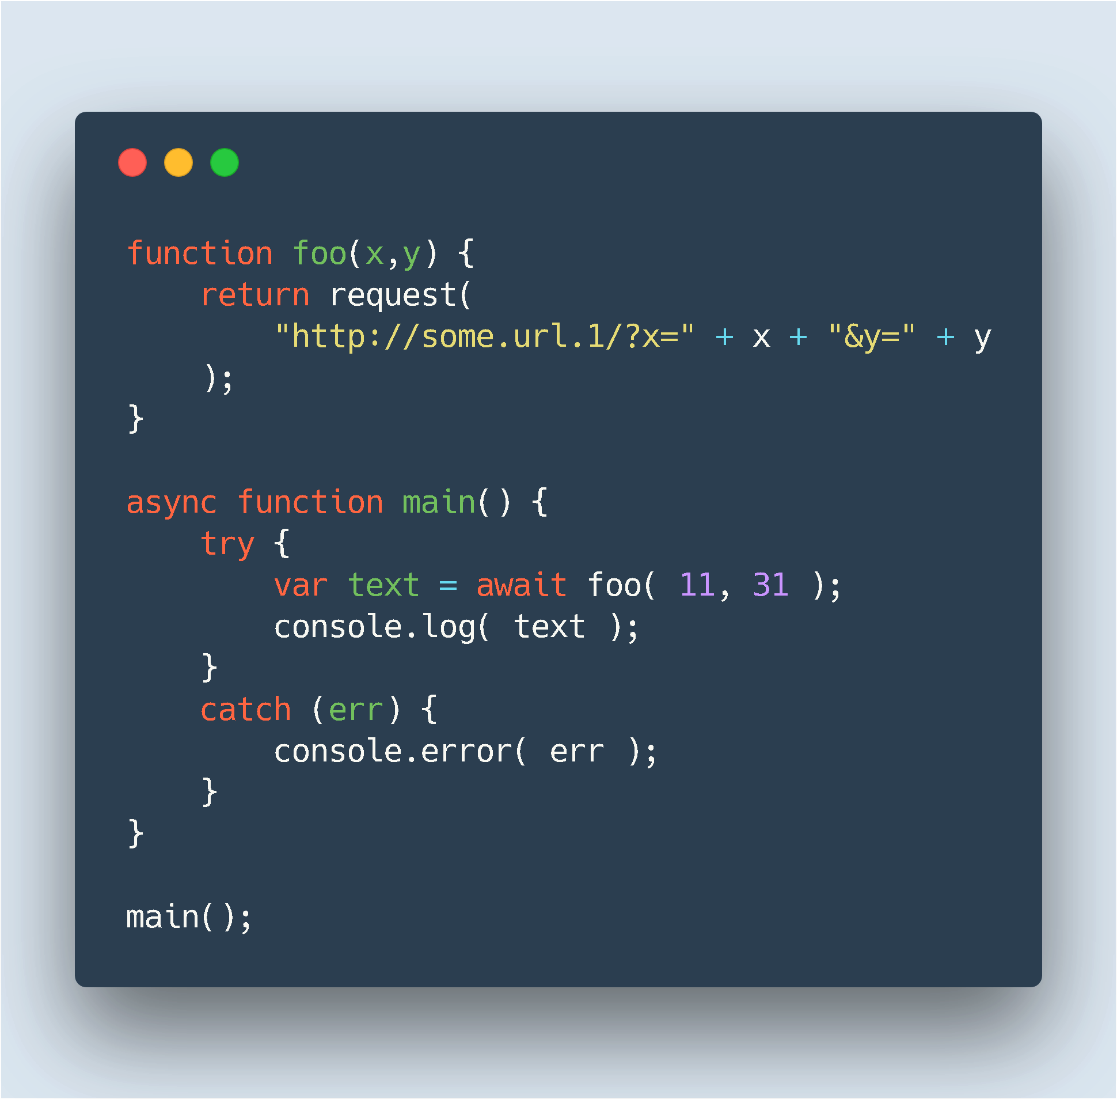
Async-Await (The best of both worlds)

Slide 20
Web workers
Use the Web Workers API
Run your JS in background threads
Non blocking : without interfering with the UI
Useful for any large computations.
Can send messages to JS code by posting messages to an event handler

Slide 21
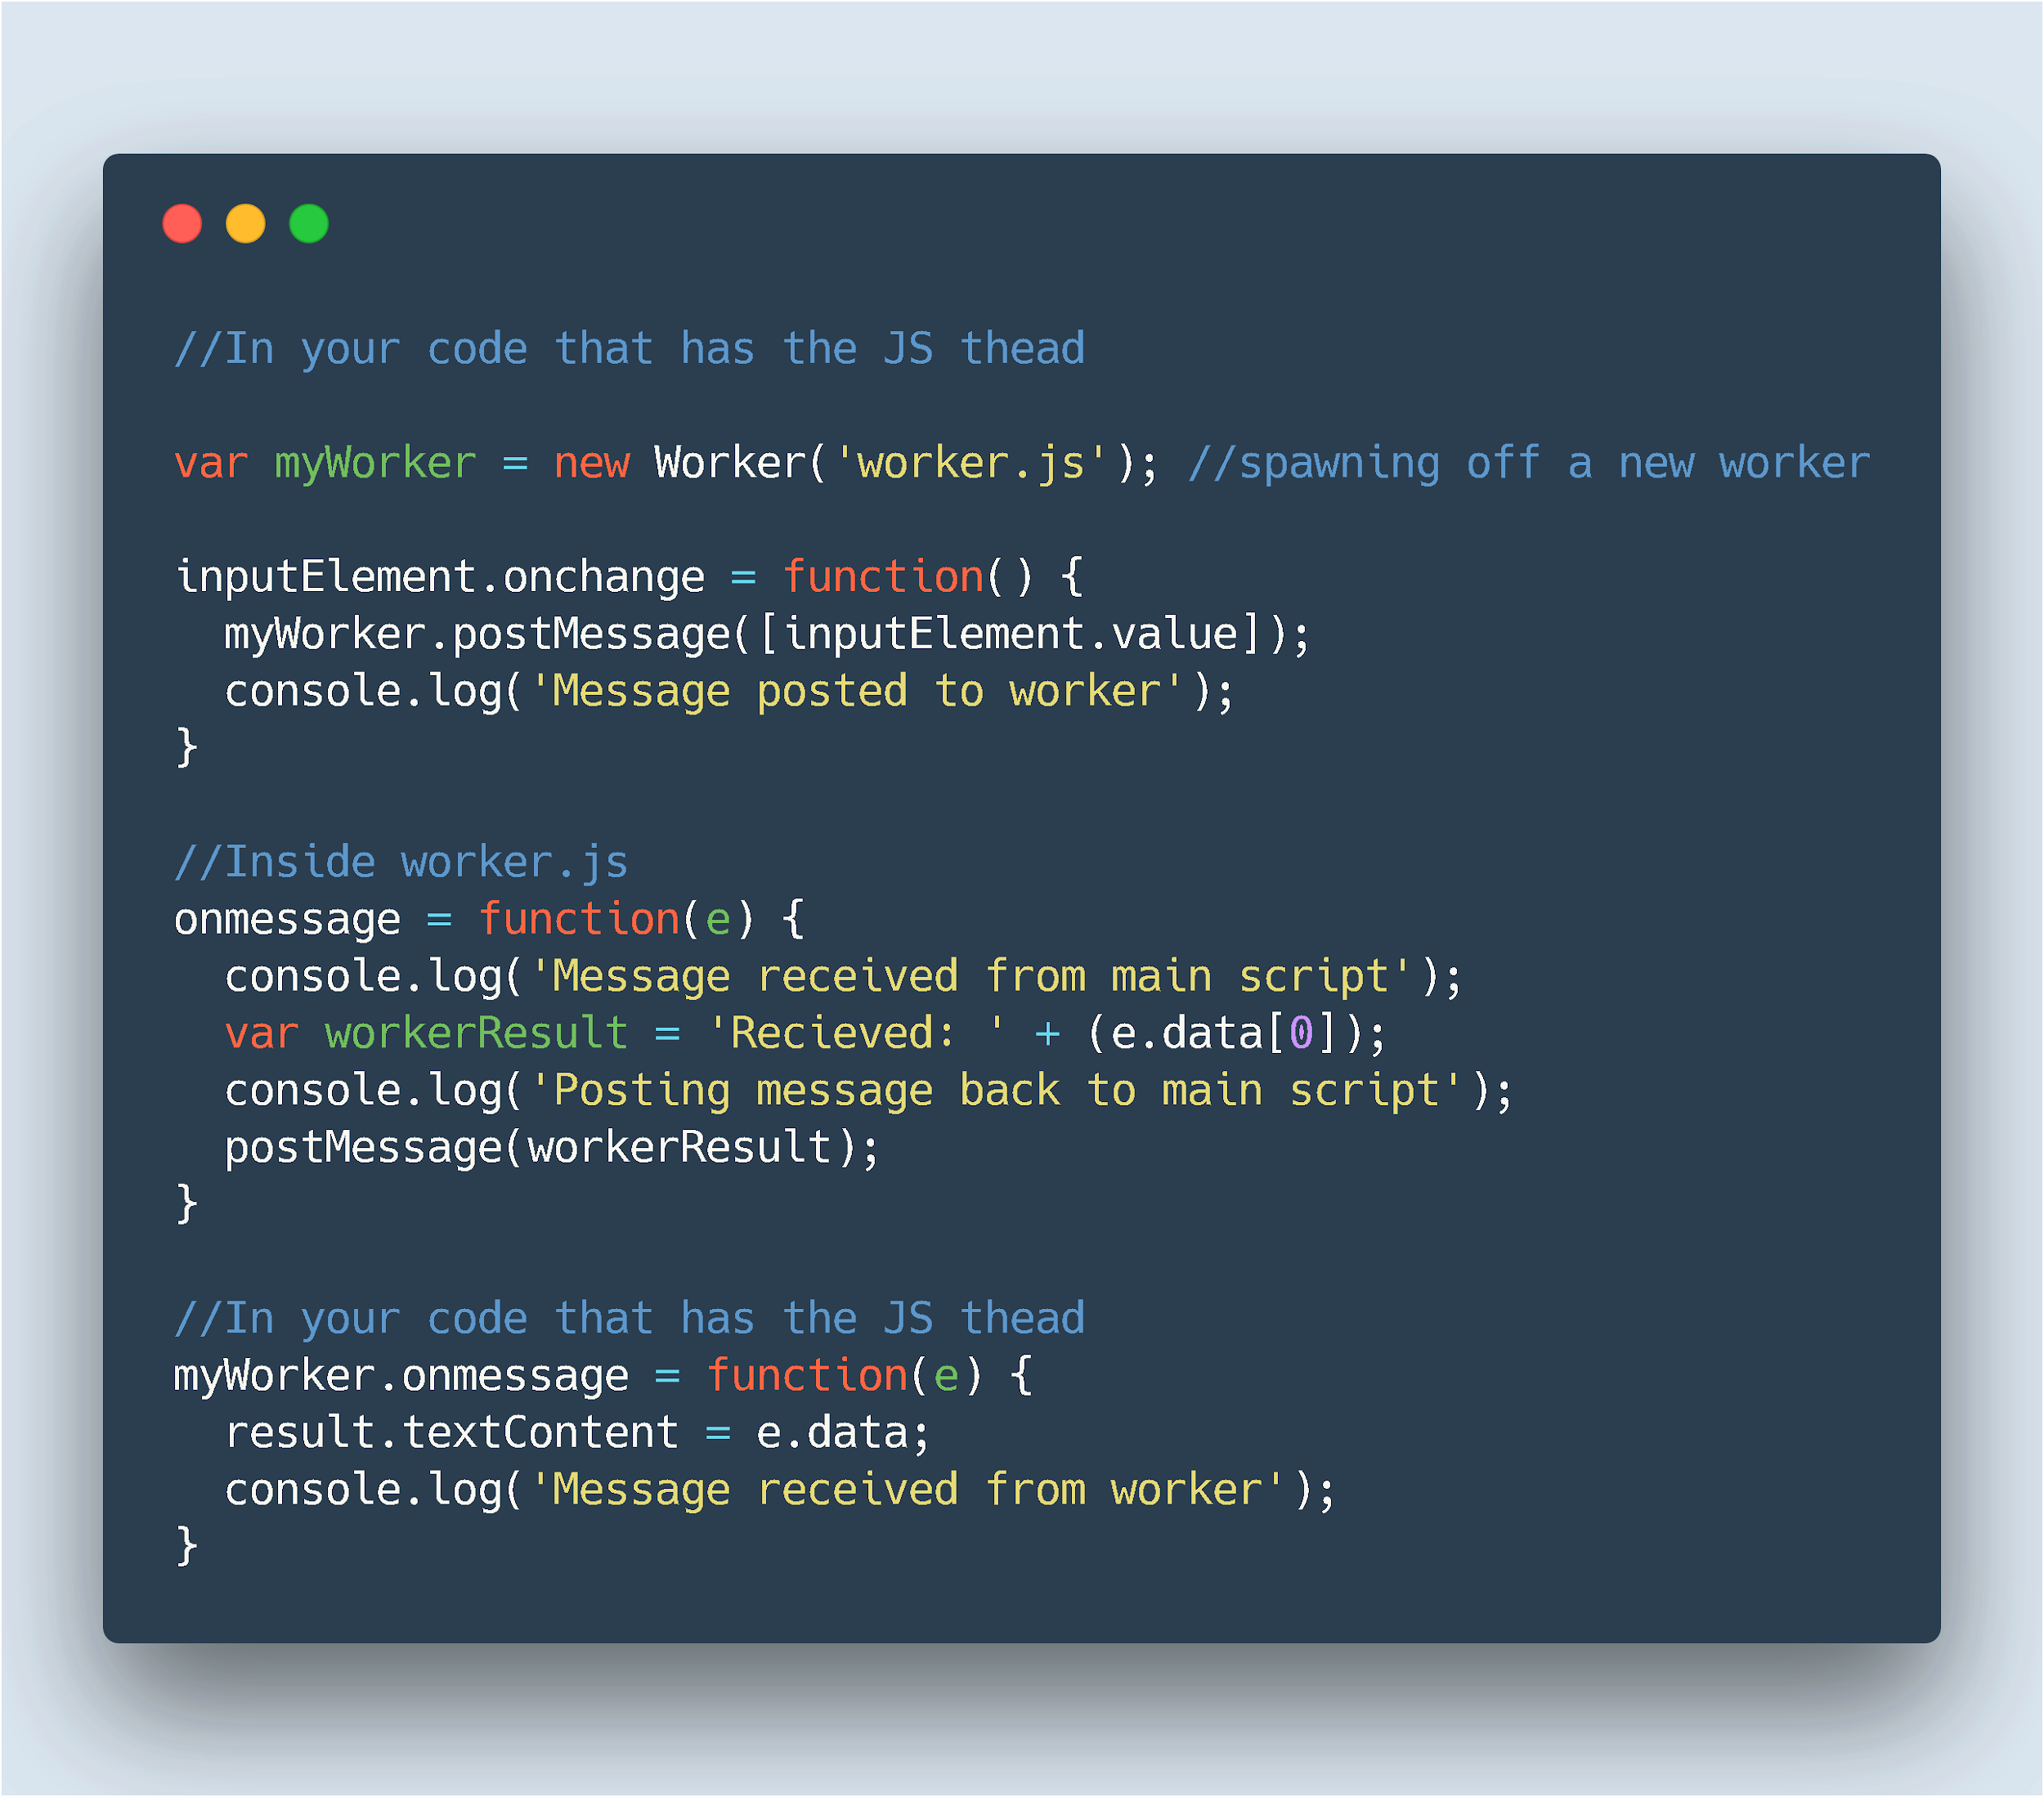

Slide 22
Observables
Suited for event streams
Avoids memory leaks
Implemented through external libraries (RxJS being the most used)
Still to make it to the spec

